Slide 1
Synthesis and Characterization of Infinite-Layer Nickelates in Thin Film and Bulk Form
Ishaan Singh Chandok
PHY479 Final Presentation

Slide 2
Background and Motivation
In 2019, Hwang et al. demonstrated superconductivity in thin film samples of Nd0.8Sr0.2NiO2 [1]
In more recent papers, Hwang et al. has also shown that Pr0.8Sr0.2NiO2 thin films superconduct [2]
As of today, no group has demonstrated superconductivity in the bulk samples
On the contrary, Wen et al. found evidence that Nd0.8Sr0.2NiO2 does not superconduct in bulk [4]
The project’s goal is to generate superconducting Nd0.8Sr0.2NiO2 thin films, and to use the ideas of [4] to synthesize Pr0.8Sr0.2NiO2 in bulk

Slide 3
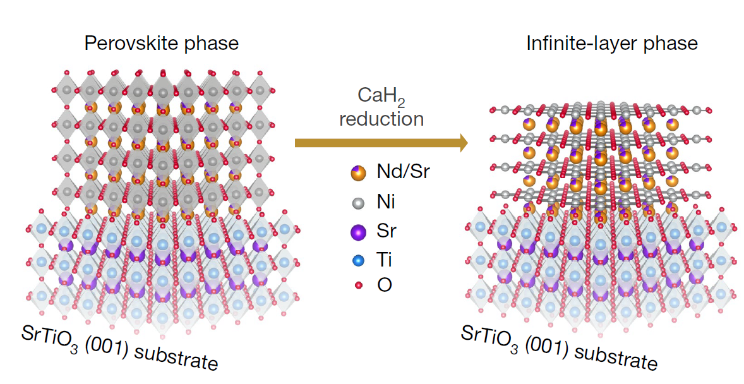
The perovskite Nd0.8Sr0.2NiO3 grown on an SrTiO3 substrate (left), and its reduction to the infinite-layer compound Nd0.8Sr0.2NiO2. Diagram taken from [1].

Slide 4
Experimental Apparatus

Slide 5
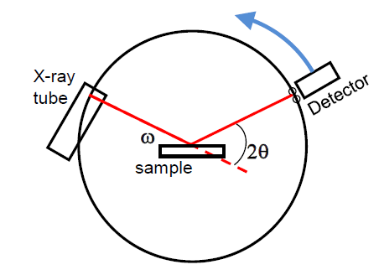
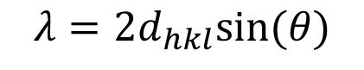
X-Ray Diffraction (XRD)
XRD is used to determine the phase and lattice parameters of thin film and powder samples
Measurements taken with the Rigaku Geigerflex, which uses the Bragg-Brentano geometry
The position of peaks is given by Bragg’s Law
The amplitude of peaks depends on the structure of the sample
Geometry of XRD Apparatus, taken from [5]
$$λ=2d_{hkl}sin⁡(θ)$$

Slide 6
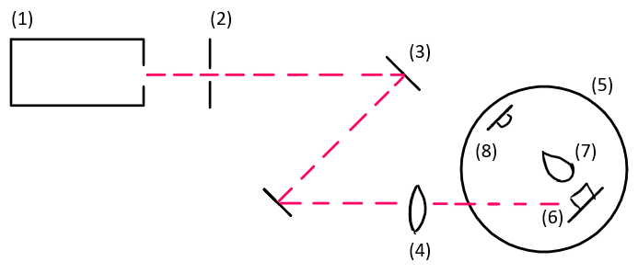
Pulsed Laser Deposition (PLD)
The PLD Apparatus. (1) 248 nm KrF Excimer Laser, (2) Slit (dimensions), (3) Lenses for reflection, (4) Convex lens, (5) PLD Chamber, (6) Target holder and target, (7) Plume, (8) Substrate heater and substrate

Slide 7
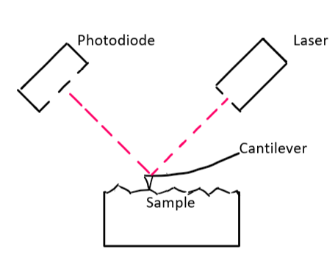
Atomic Force Microscopy (AFM)
AFM is used to determine the topography of a sample
Topography is determined by measuring the deflection of a probe in contact with the surface of the sample
In this experiment, AFM measurements are used to determine the thickness of the films

Slide 8
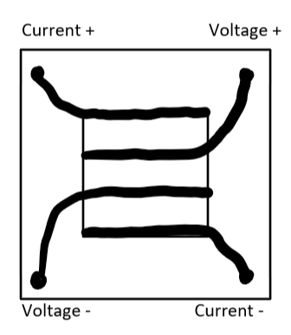
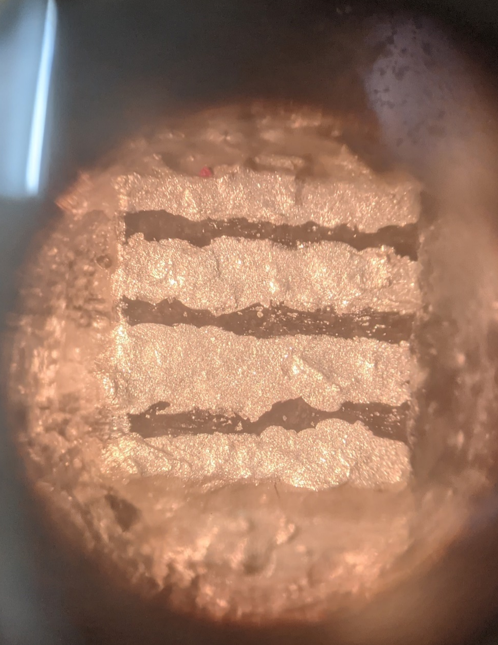
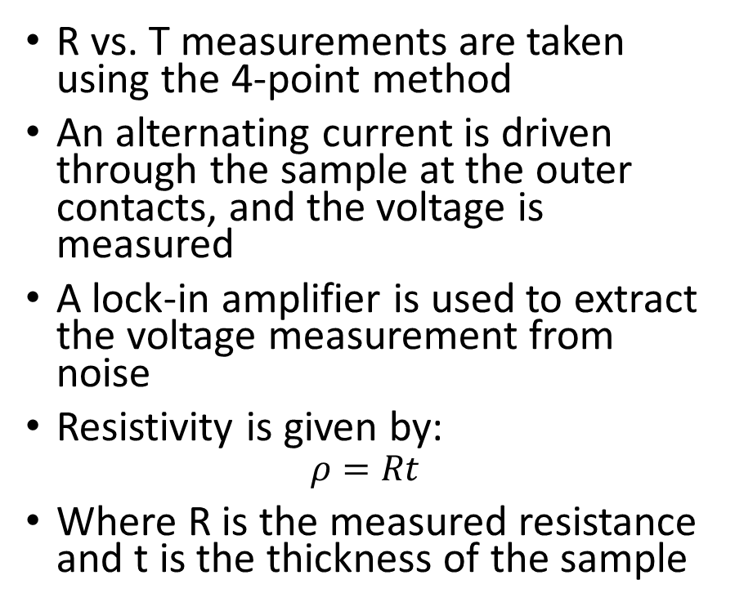
Resistance vs. Temperature (R vs. T)
R vs. T measurements are taken using the 4-point method
An alternating current is driven through the sample at the outer contacts, and the voltage is measured
A lock-in amplifier is used to extract the voltage measurement from noise
Resistivity is given by:
$$ρ=Rt$$
Where R is the measured resistance and t is the thickness of the sample

Slide 9
Experiment 1 – Synthesis and Characterization of Nd0.8Sr0.2NiO2 Thin Films

Slide 10
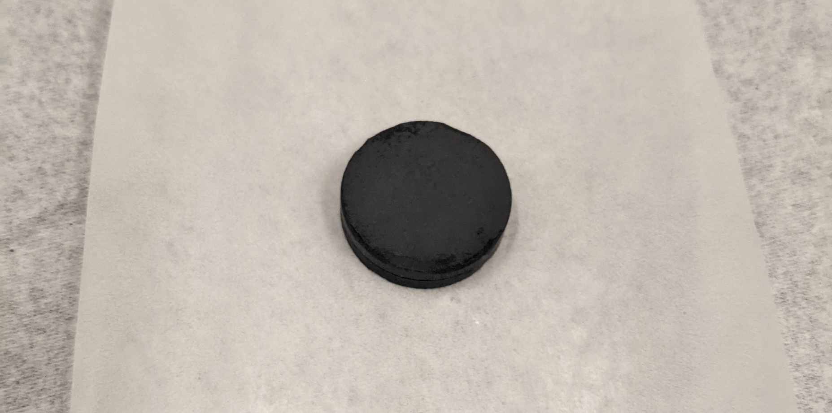
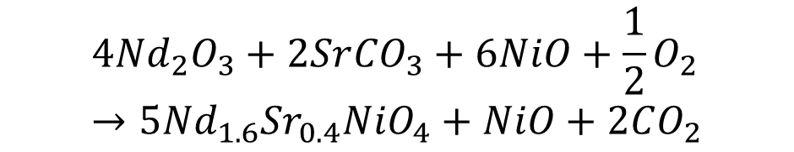
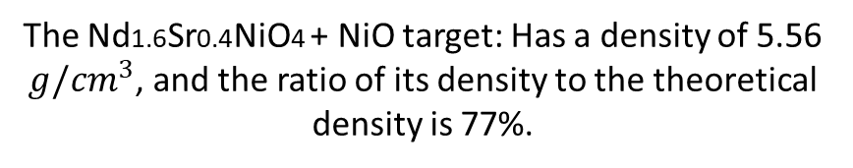
Step 1 - Synthesis of Target
The precursors Nd2O3, NiO and SrCO3 were measured in the stoichiometry of Nd0.8Sr0.2NiO3, and ground using a mortar and pestle
The precursor was placed in a furnace at 1200 °C for 24 hours
The resulting powder was ground and placed in a furnace at 1350 °C for 24 hours
The powder was immersed in isopropyl alcohol and ground
The powder was finally pressed into a 2 cm pellet
The reaction produces a mixed phase target of Nd1.6Sr0.4NiO4 + NiO, in the stoichiometry of Nd0.8Sr0.2NiO3
$$4{Nd}_{2}O_{3}+2Sr{CO}_{3}+6NiO+\frac{1}{2}O_{2}→5{Nd}_{1.6}{Sr}_{0.4}NiO_{4}+NiO+2CO_{2}$$
The Nd1.6Sr0.4NiO4 + NiO target: Has a density of 5.56 $g/{cm}^{3}$, and the ratio of its density to the theoretical density is 77%.

Slide 11
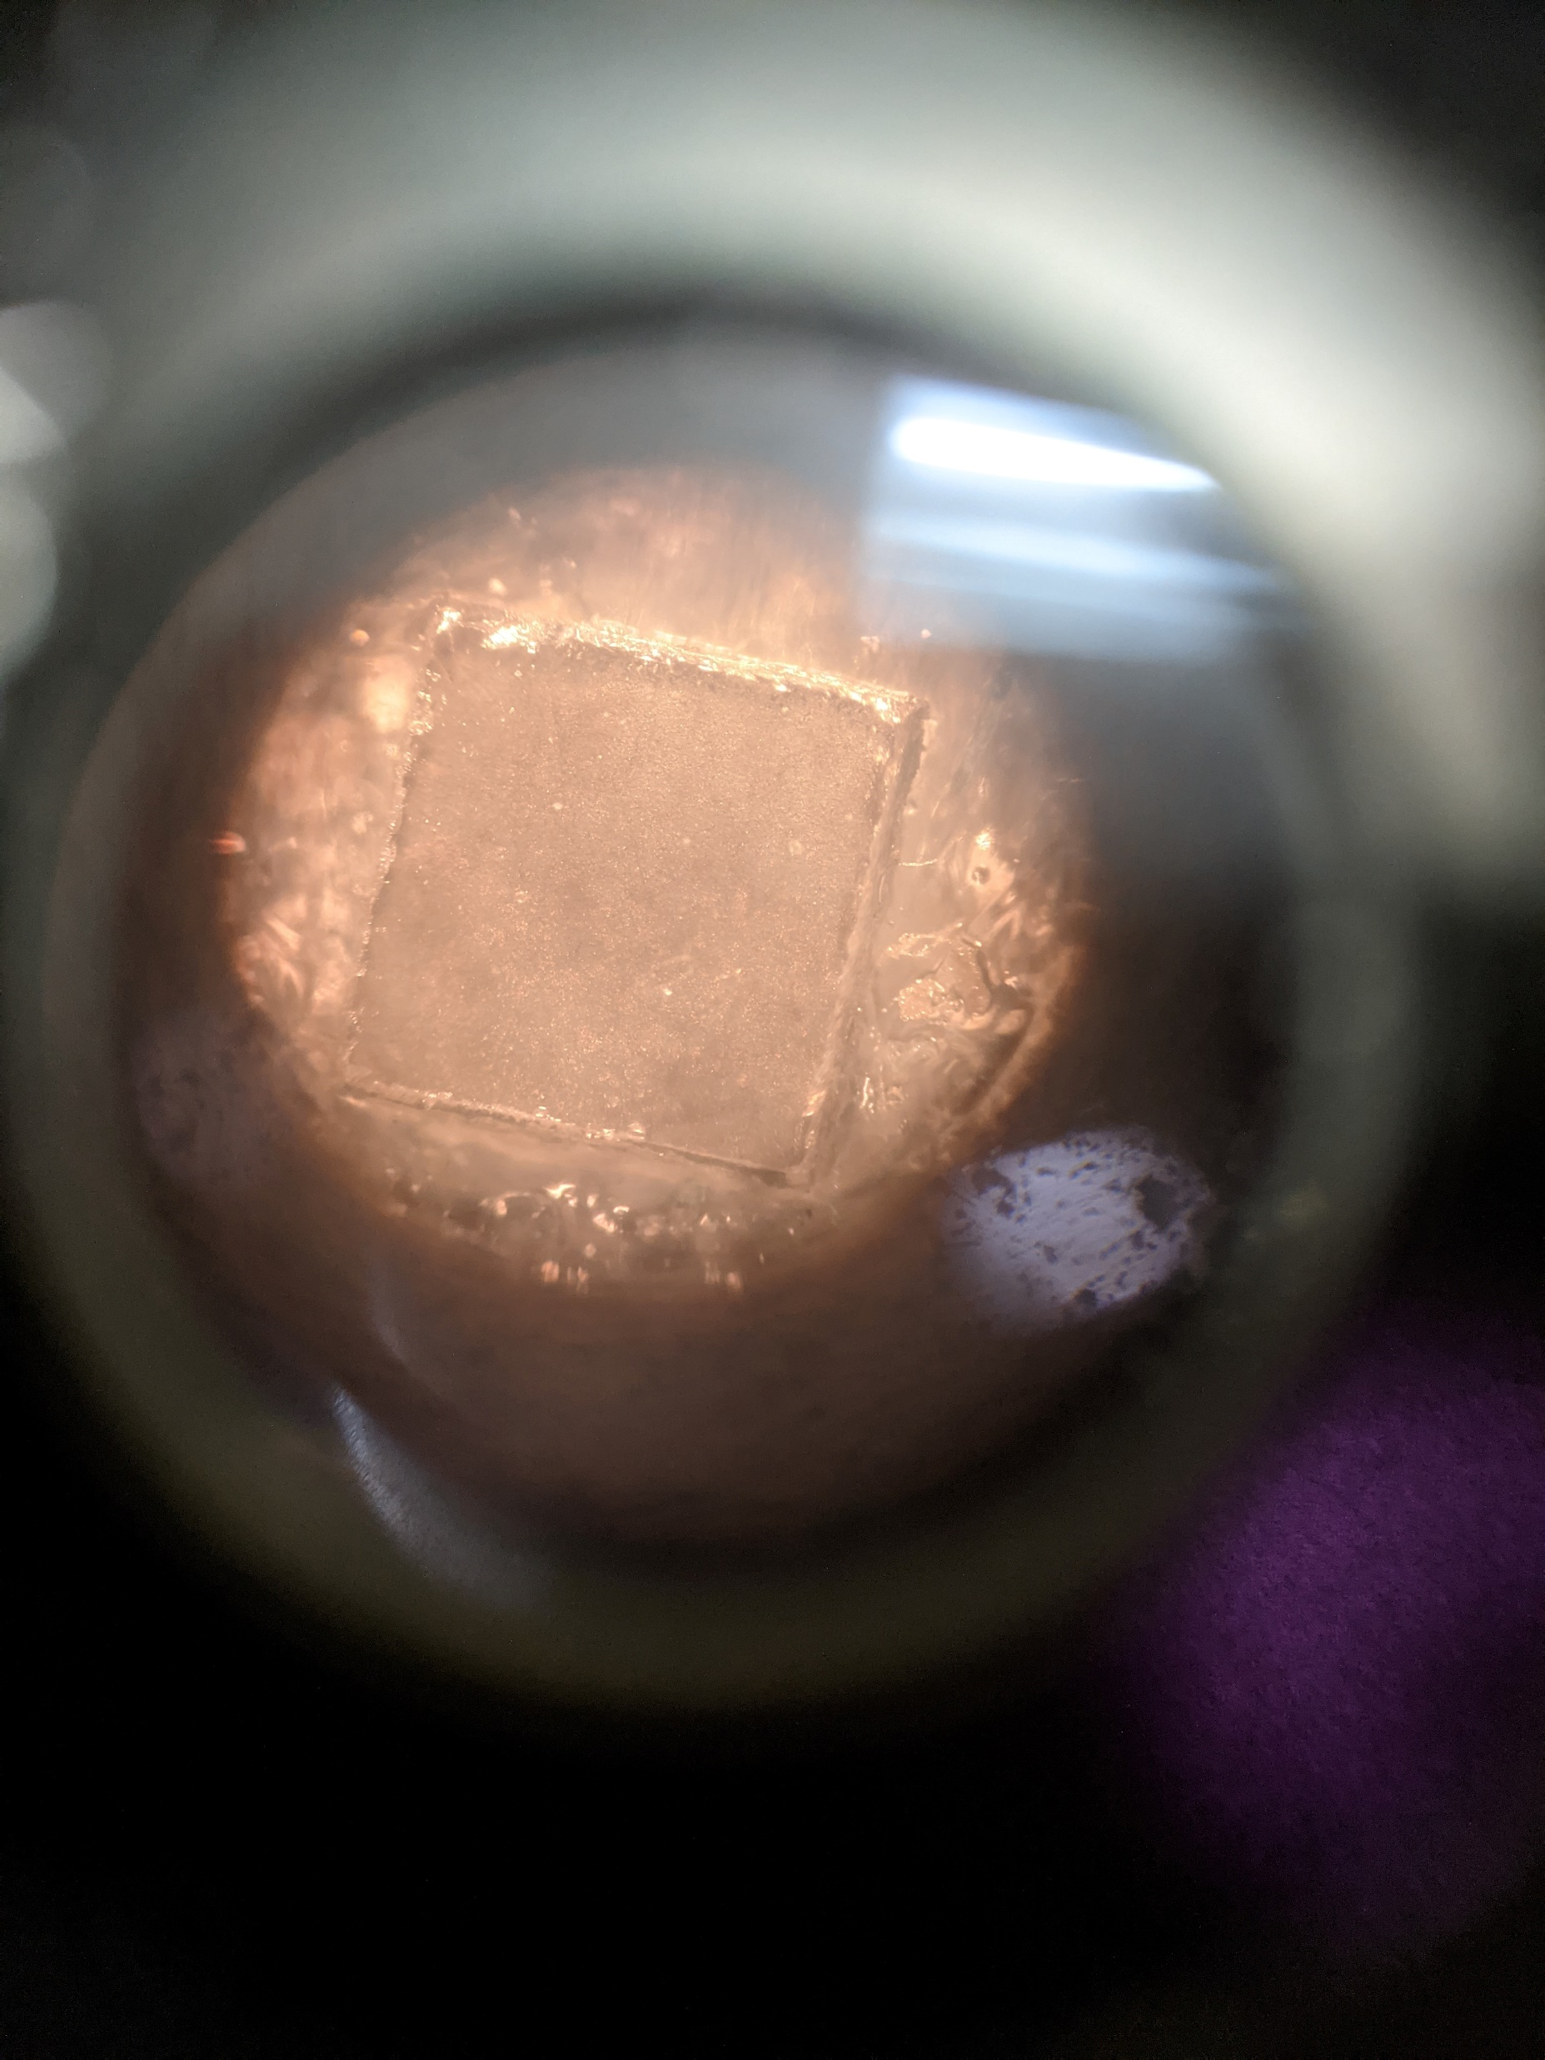
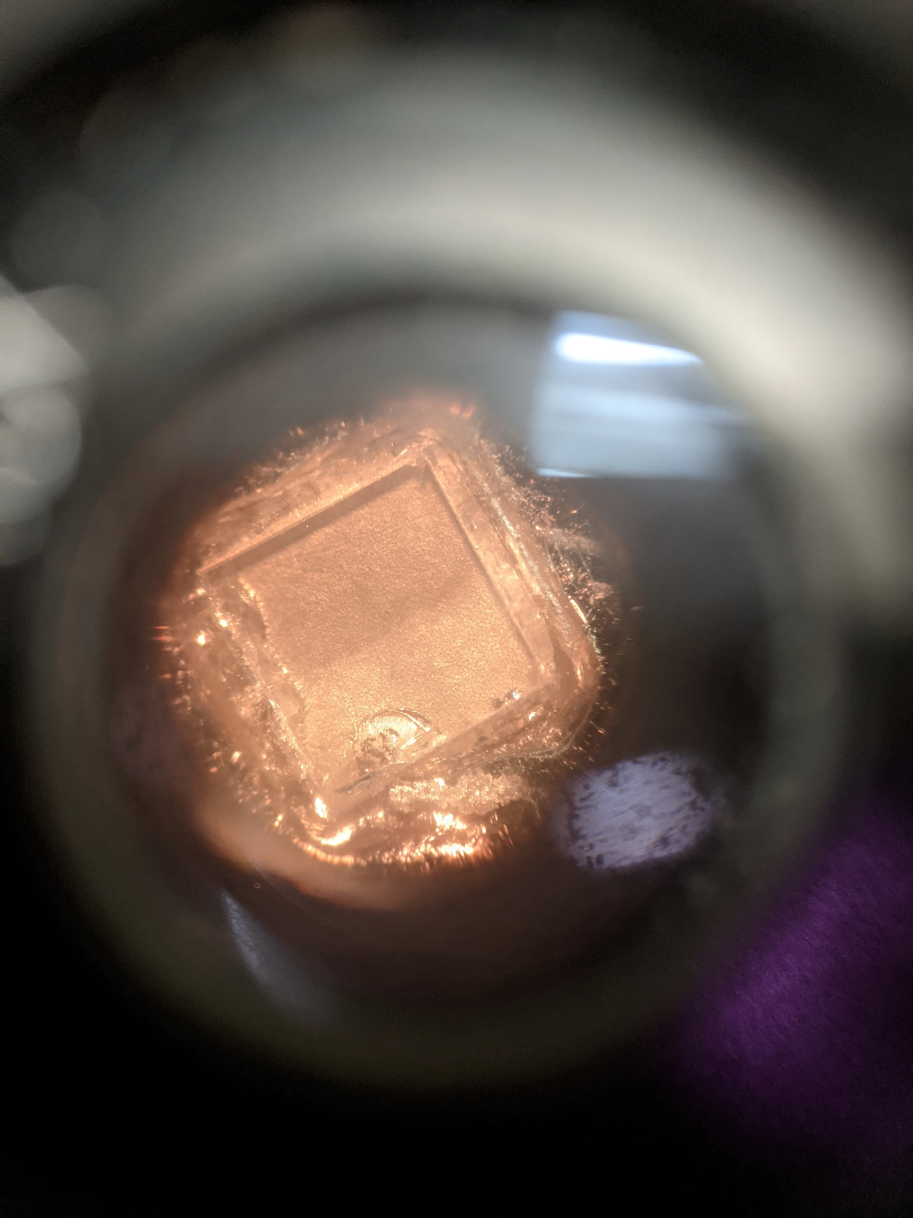
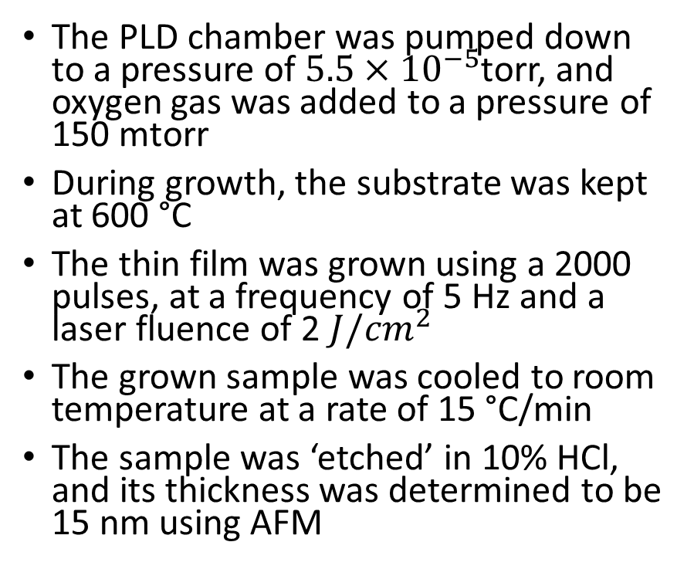
Step 2 - Synthesis of Thin Films
The PLD chamber was pumped down to a pressure of $5.5×{10}^{−5}$torr, and oxygen gas was added to a pressure of 150 mtorr
During growth, the substrate was kept at 600 °C
The thin film was grown using a 2000 pulses, at a frequency of 5 Hz and a laser fluence of 2 $J/{cm}^{2}$
The grown sample was cooled to room temperature at a rate of 15 °C/min
The sample was ‘etched’ in 10% HCl, and its thickness was determined to be 15 nm using AFM

Slide 12
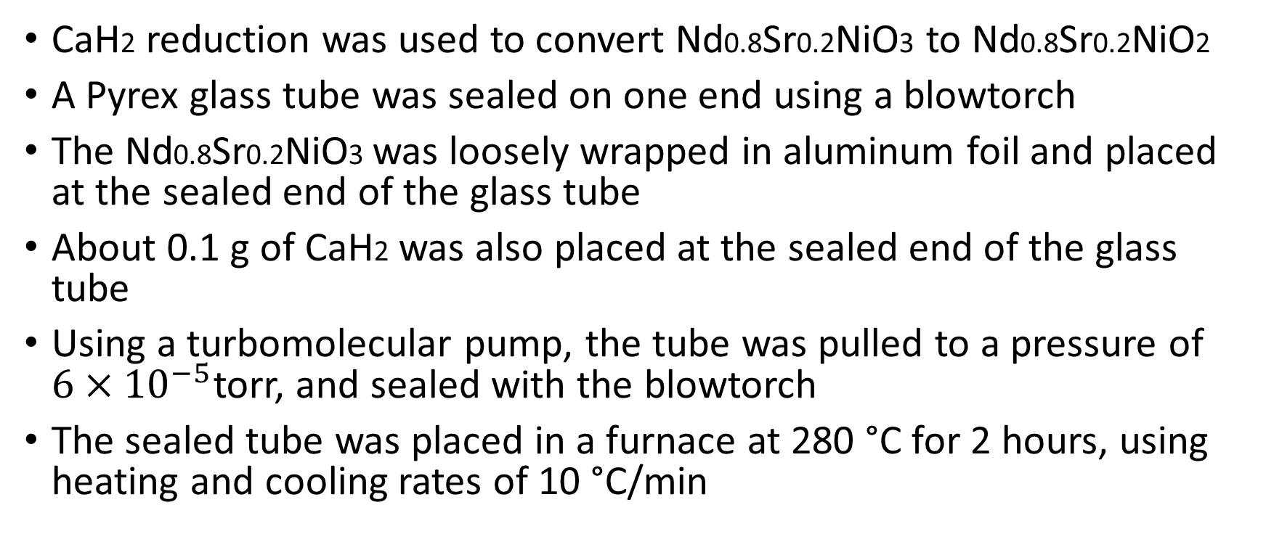
Step 3 - Reduction of Film
CaH2 reduction was used to convert Nd0.8Sr0.2NiO3 to Nd0.8Sr0.2NiO2
A Pyrex glass tube was sealed on one end using a blowtorch
The Nd0.8Sr0.2NiO3 was loosely wrapped in aluminum foil and placed at the sealed end of the glass tube
About 0.1 g of CaH2 was also placed at the sealed end of the glass tube
Using a turbomolecular pump, the tube was pulled to a pressure of $6×{10}^{−5}$torr, and sealed with the blowtorch
The sealed tube was placed in a furnace at 280 °C for 2 hours, using heating and cooling rates of 10 °C/min

Slide 13
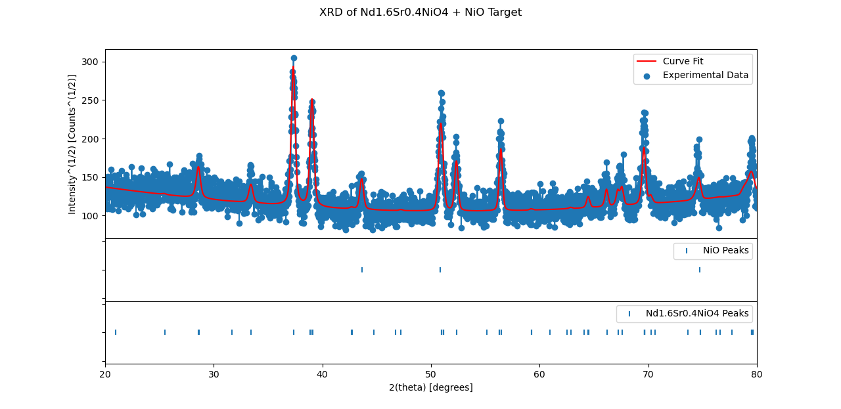

Slide 14
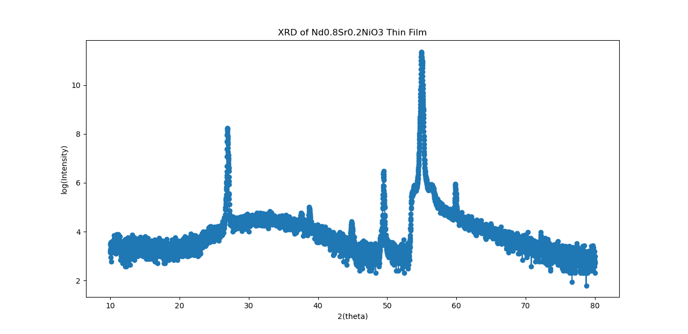
SrTiO3 (002)
SrTiO3 (001)
Nd1.6Sr0.4NiO4 (006)
Nd0.8Sr0.2NiO3 (002)

Slide 15
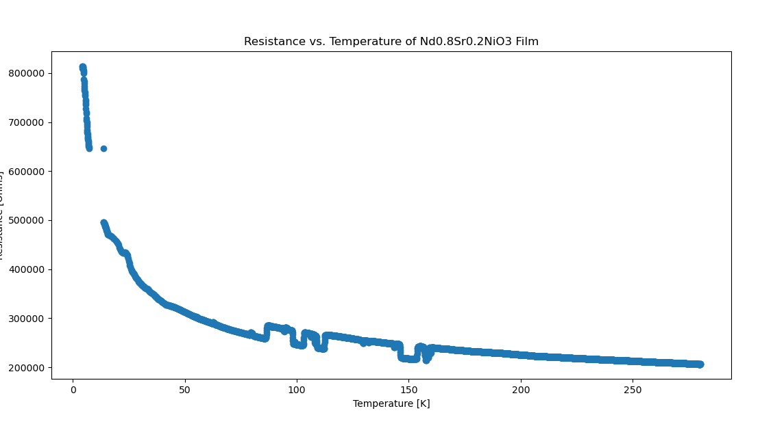

Slide 16
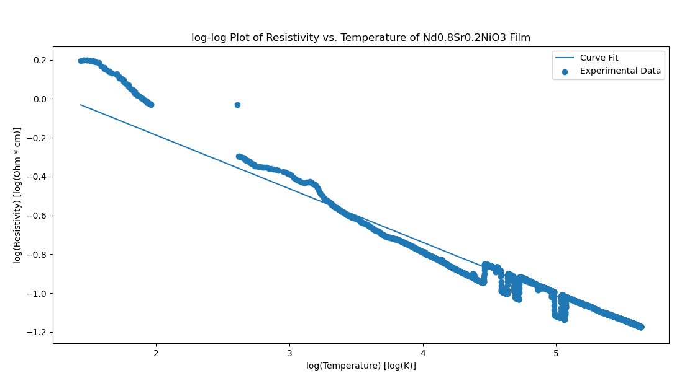
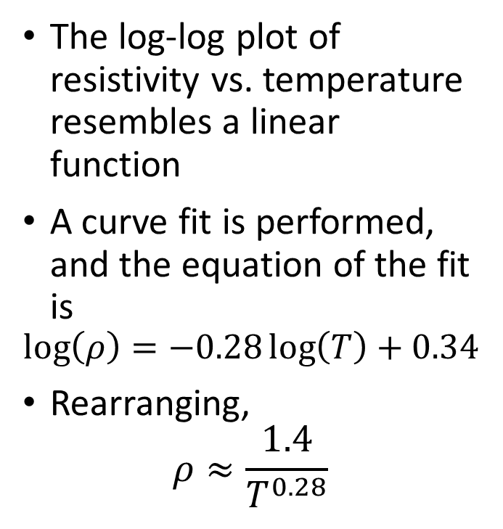
R vs T
The log-log plot of resistivity vs. temperature resembles a linear function
A curve fit is performed, and the equation of the fit is
$$\log\left(ρ\right)=−0.28\log\left(T\right)+0.34$$
Rearranging,
$$ρ≈\frac{1.4}{T^{0.28}}$$

Slide 17
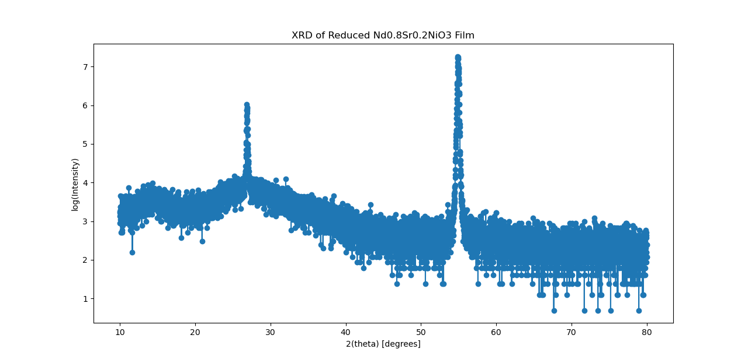
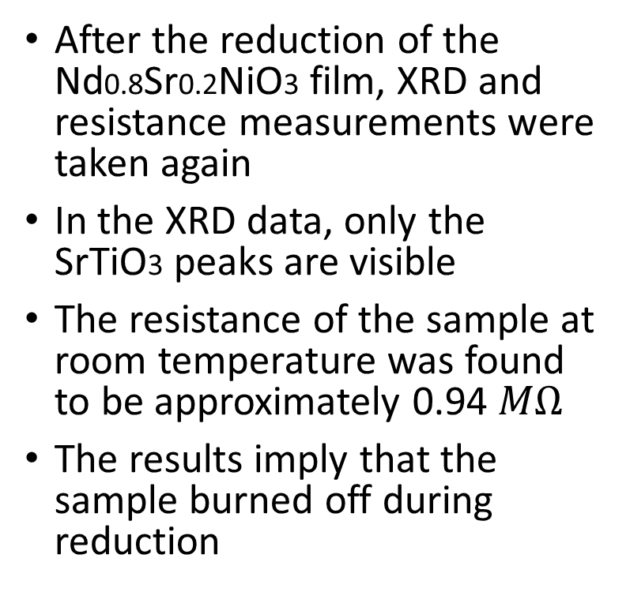
Reduced Film Measurements
After the reduction of the Nd0.8Sr0.2NiO3 film, XRD and resistance measurements were taken again
In the XRD data, only the SrTiO3 peaks are visible
The resistance of the sample at room temperature was found to be approximately 0.94 $MΩ$
The results imply that the sample burned off during reduction
SrTiO3 (002)
SrTiO3 (001)
XRD of Reduced Nd0.8Sr0.2NiO3 Film, taken with a Cobalt anode.

Slide 18

Discussion and Next Steps
The grown Nd0.8Sr0.2NiO3 film is comprised of three compounds: Nd1.6Sr0.4NiO4, Nd0.8Sr0.2NiO3 and SrTiO3
To ensure that only the Nd0.8Sr0.2NiO3 phase grows during PLD, higher oxygen pressure can be used, and the film should be grown to a maximum thickness of 10 nm
Using a lower reduction time or growing a SrTiO3 capping layer would decrease the chance of the Nd0.8Sr0.2NiO3 film burning off during reduction
Nd1.6Sr0.4NiO4
(Insulating)
Nd0.8Sr0.2NiO3
(Metallic)
SrTiO3
(Insulating)

Slide 19
Experiment 2 – Synthesis of Pr0.8Sr0.2NiO2 in Bulk

Slide 20
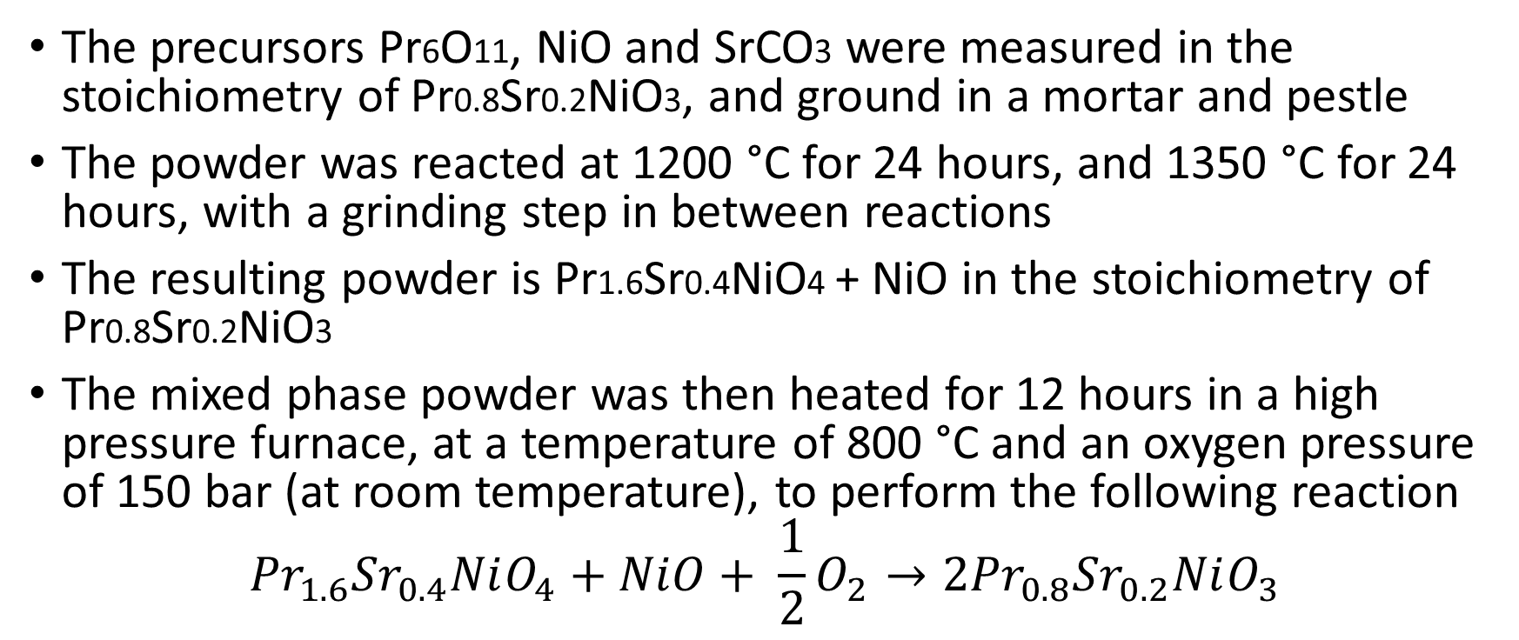
Bulk Pr0.8Sr0.2NiO3 Synthesis
The precursors Pr6O11, NiO and SrCO3 were measured in the stoichiometry of Pr0.8Sr0.2NiO3, and ground in a mortar and pestle
The powder was reacted at 1200 °C for 24 hours, and 1350 °C for 24 hours, with a grinding step in between reactions
The resulting powder is Pr1.6Sr0.4NiO4 + NiO in the stoichiometry of Pr0.8Sr0.2NiO3
The mixed phase powder was then heated for 12 hours in a high pressure furnace, at a temperature of 800 °C and an oxygen pressure of 150 bar (at room temperature), to perform the following reaction
$${{Pr}_{1.6}{Sr}_{0.4}NiO_{4}+NiO+ \frac{1}{2}O_{2}→2Pr}_{0.8}{Sr}_{0.2}NiO_{3}$$

Slide 21
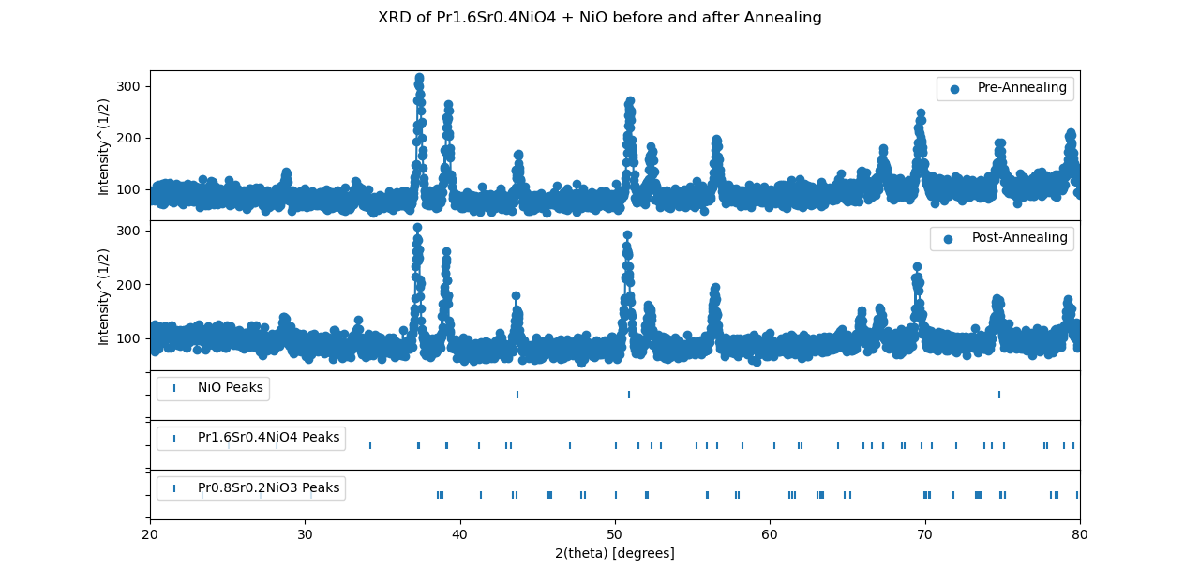

Slide 22
Discussion and Next Steps
The sample does not change after heating in the high-pressure furnace
The reaction could occur if it is done multiple times with intermediate grinding steps

Slide 23
Resources
[1] Li, D., Lee, K., Wang, B.Y. et al. Superconductivity in an infinite-layer nickelate. Nature 572, 624–627 (2019). https://doi.org/10.1038/s41586-019-1496-5
[2] Osada, M., Wang, B.Y. et al. A Superconducting Praseodymium Nickelate with Infinite Layer Structure. Nano Letters 2020 20 (8), 5735-5740. 10.1021/acs.nanolett.0c01392
[3] Osada, M., Wang, B.Y. et al. Nickelate Superconductivity without Rare-Earth Magnetism: (La,Sr)NiO2. Adv. Mater. 2021, 33, 2104083. https://doi.org/10.1002/adma.202104083
[4] Li, Q., He, C., Si, J. et al. Absence of superconductivity in bulk Nd1−xSrxNiO2. Commun Mater 1, 16 (2020). https://doi.org/10.1038/s43246-020-0018-1
[5] http://prism.mit.edu/xray/documents/1%20Basics%20of%20X-Ray%20Powder%20Diffraction.pdf

Slide 24
References
[6] https://arxiv.org/ftp/arxiv/papers/2106/2106.12941.pdf
[7] Li, K., et al. APL Mater. 8, 041107 (2020); https://doi.org/10.1063/5.0005103
[8] Ph. Lacorre, Passage from T-type to T′-type arrangement by reducing R4Ni3O10 to R4Ni3O8 (R = La, Pr, Nd), Journal of Solid State Chemistry, Volume 97, Issue 2, 1992, Pages 495-500, ISSN 0022-4596, https://doi.org/10.1016/0022-4596(92)90061-Y.
[9] Tung, IC., et al. Connecting bulk symmetry and orbital polarization in strained RNiO3 ultrathin films, Phys. Rev. B 88, 205112. https://doi.org/10.1103/PhysRevB.88.205112
[10] Kittel, Charles. Introduction to Solid State Physics. 8 ed. John Wiley and Sons. 2005.

Slide 25
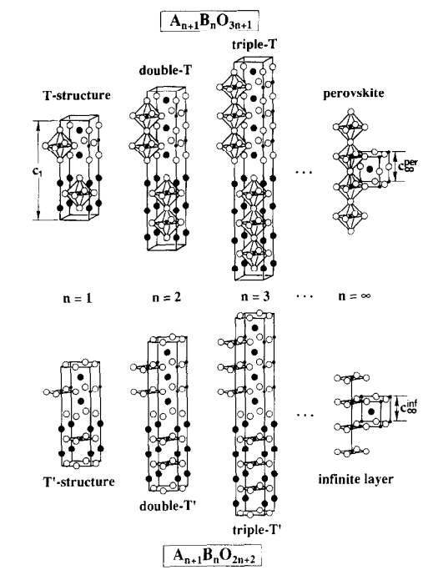
Ruddlesden-Popper and Reduced RP Phases
Diagram taken from [8]

Slide 26
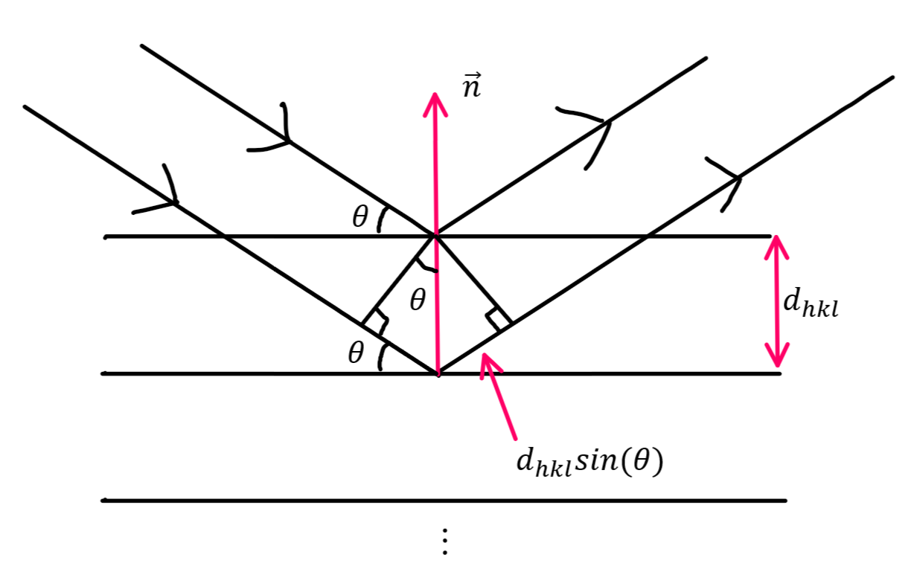
Derivation of Bragg’s Law

Slide 27
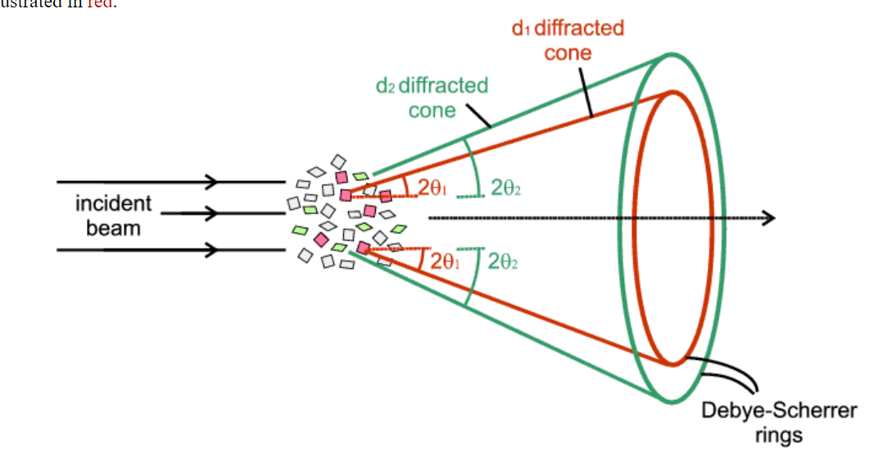
Powder XRD
Diagram taken from http://pd.chem.ucl.ac.uk/pdnn/diff2/kinemat2.htm

Slide 28
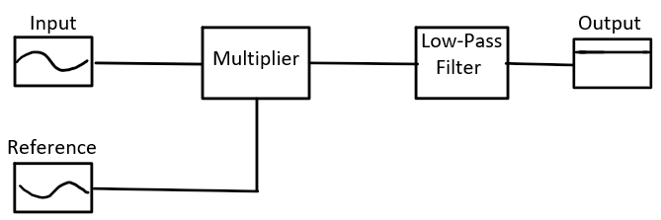
Lock-In Amplifier

Slide 29
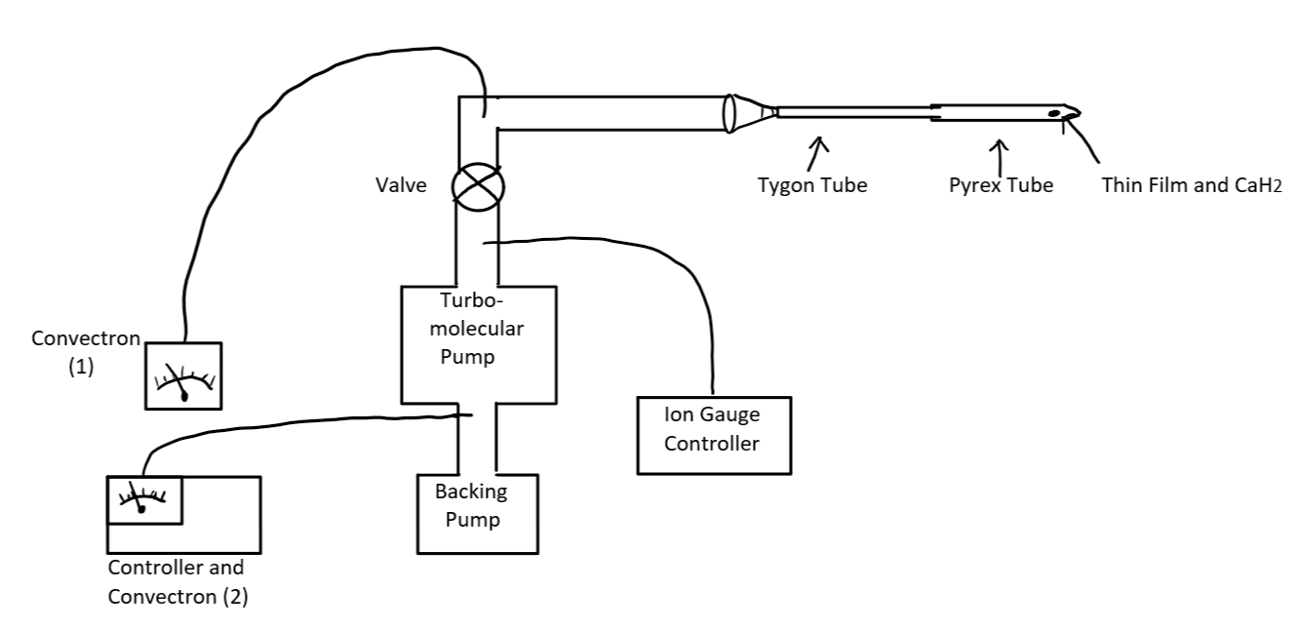
Reduction Apparatus

Slide 30
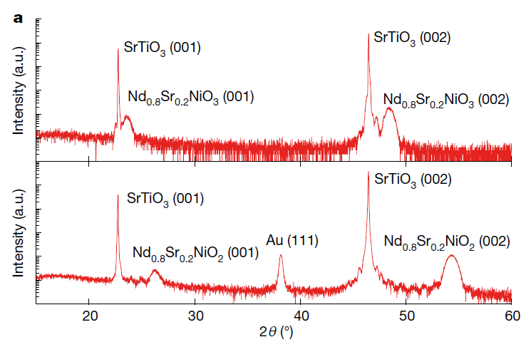
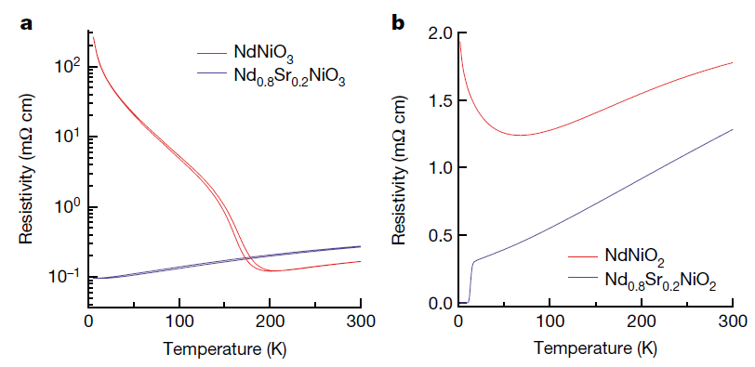
Stanford Results
XRD on 11 nm thin film sample, Cu anode. Taken from [1].
R vs. T before and after reduction. Taken from [1]

Slide 31
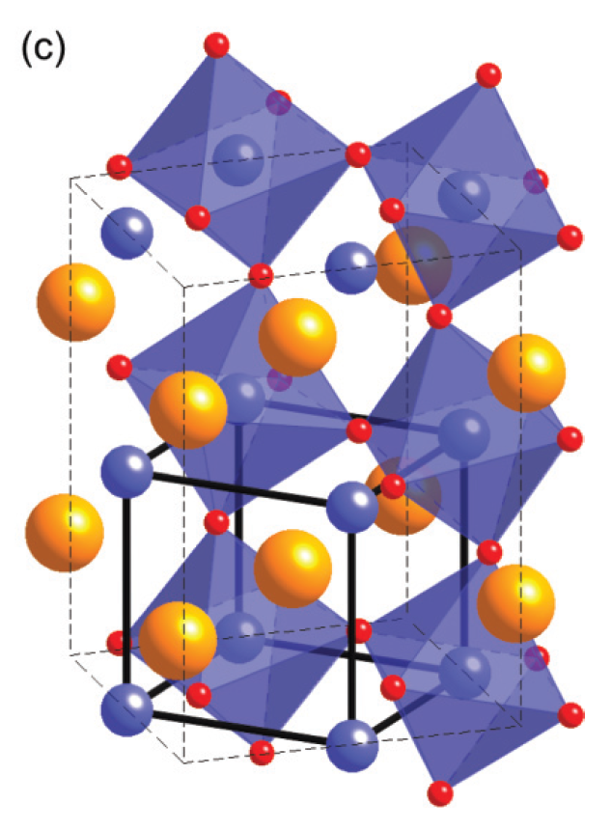
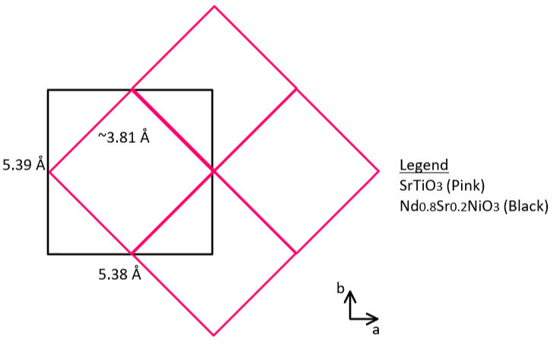
Growth on SrTiO3 Substrate
Diagram taken from [9]

Slide 32
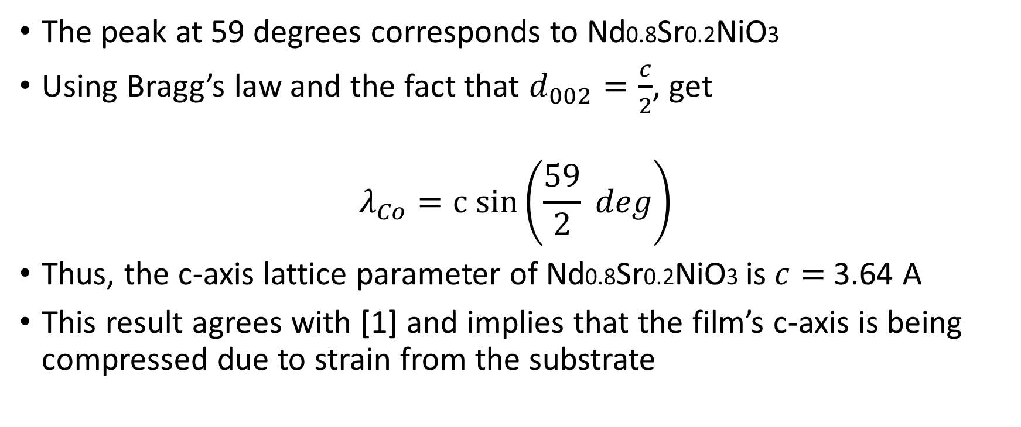
Calculating Lattice Parameters
The peak at 59 degrees corresponds to Nd0.8Sr0.2NiO3
Using Bragg’s law and the fact that $d_{002}=\frac{c}{2}$, get
$$λ_{Co}=c sin⁡\left(\frac{59}{2} deg\right)$$
Thus, the c-axis lattice parameter of Nd0.8Sr0.2NiO3 is $c=$ 3.64 A
This result agrees with [1] and implies that the film’s c-axis is being compressed due to strain from the substrate

Slide 34
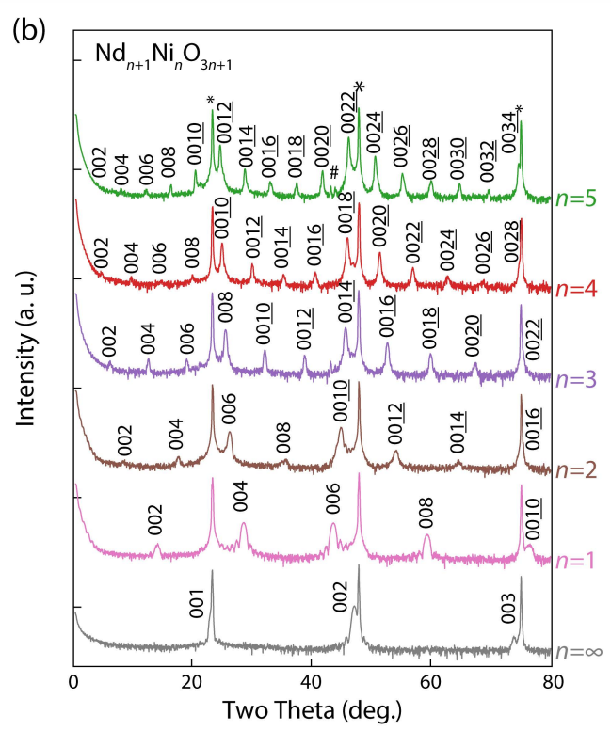
Justification of Slide 15
Diagram from [6]

Slide 35
SrTiO3 (002)
SrTiO3 (001)

Slide 36
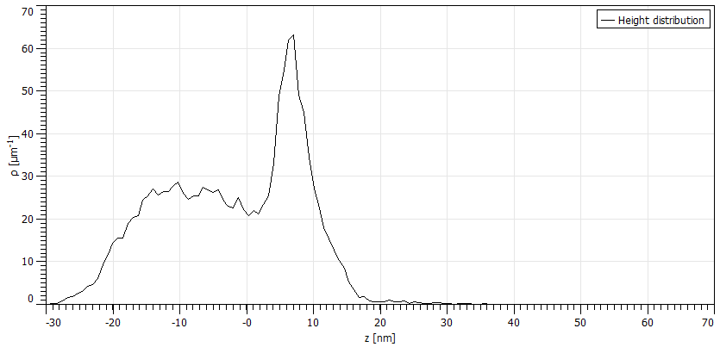

Distribution of Thickness in Etched Film
Frequency
Thickness [nm]

